Slide 1
Analyzing Code in .NET
Jason Bock
Practice Lead

Slide 2
Personal Info
http://www.magenic.com
http://www.jasonbock.net
https://www.twitter.com/jasonbock
https://www.github.com/jasonbock
jasonb@magenic.com

Slide 3
Downloads
https://github.com/JasonBock/Presentations/blob/master/
Analyzing%20Code%20In%20.NET.pptx
https://github.com/JasonBock/AnalyzingCodeInDotNet
https://github.com/MarimerLLC/csla

Slide 4
Overview
Analysis
Building
Conclusion
Remember….
https://github.com/JasonBock/Presentations/blob/master/
Analyzing%20Code%20In%20.NET.pptx
https://github.com/JasonBock/AnalyzingCodeInDotNet
https://github.com/MarimerLLC/csla

Slide 5

Analysis
http://www.tacomanarrowsbridge.org/z1940-100.jpg
Notes:
We have the best of intentions, and we are smart, intelligent folks. But we're falliable…

Slide 6
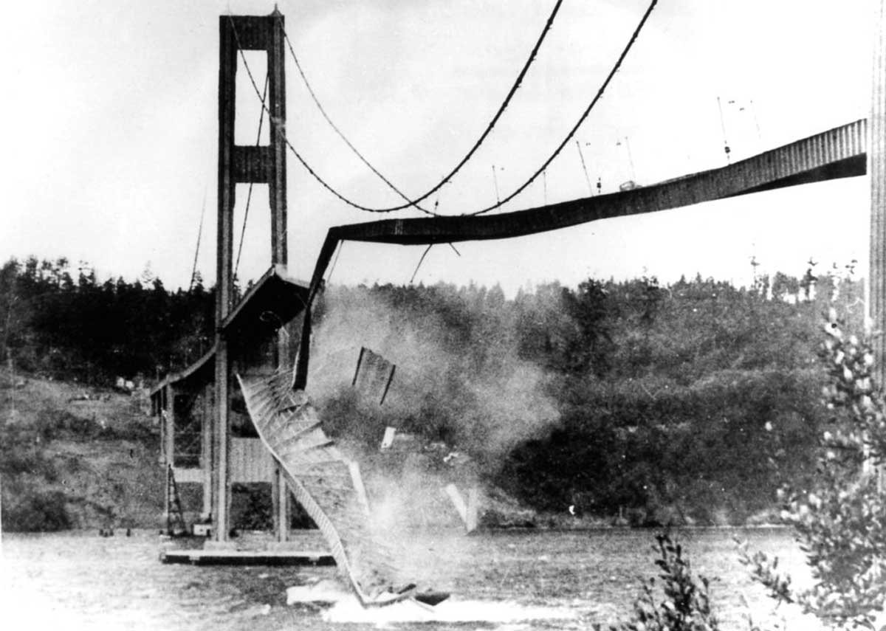
Analysis
http://exit133.com/uploads/Narrows-Bridge-Collapse.jpg
Notes:
If there's a truism in code, it's that we'll write code that fails. And sometimes that happens spectacularly.

Slide 7
Analysis
var source = /* reference to array */
var destination = new int[0];
foreach(var item in source)
{
var holder = new int[destination.Length + 1];
destination.CopyTo(holder, 0);
holder[destination.Length] = item;
destination = holder;
}
Notes:
Sometimes, it’s obvious when someone has written a train wreck. This code copies the contents of an array (source) to destination. But….all it needed to do was call:
source.CopyTo(destination, 0); // assume destination is the same size as source.
(Yes, this was code I found in a production app that had been live for at least 10 years. Copies of it were all over the place.)

Slide 8

Analysis
http://a.dilcdn.com/bl/wp-content/uploads/sites/8/2012/04/rattled.jpg
Notes:
In this case, I think any dev would see this right away and have this look on their face ☺

Slide 9

Analysis
http://images.dpchallenge.com/images_challenge/0-999/806/1200/Copyrighted_Image_Reuse_Prohibited_636539.jpg
Notes:
Other times, it’s much harder to see the bug.

Slide 10
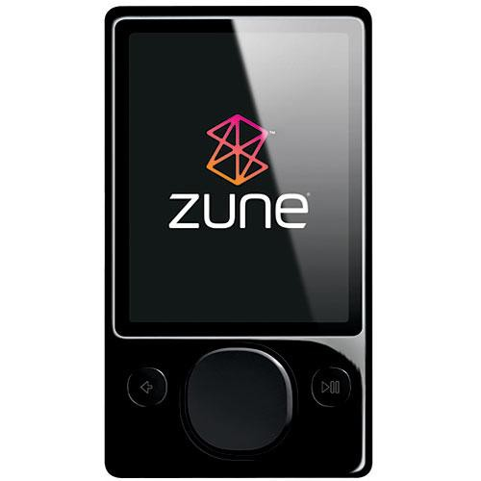
Analysis
year = ORIGINYEAR; /* = 1980 */
while (days > 365)
{
if (IsLeapYear(year))
{
if (days > 366)
{
days -= 366;
year += 1;
}
}
else
{
days -= 365;
year += 1;
}
}
?
"A bug in the internal clock driver related to the way the device handles a leap year affected Zune users," said the company in a statement. "That being the case, the issue should be resolved over the next 24 hours as the time change moves to January 1, 2009."
http://www.hanselman.com/blog/BackToBasicsExploreTheEdgeCasesOrDateMathWillGetYou.aspx
https://www.wired.com/2008/12/zune-freeze-res/
Notes:
This code is from the Zune. Do you think you could’ve caught the error at first glance?

Slide 11

Analysis
/* generated code */
if ( ++p == pe )
goto _test_eof;
The root cause of the bug was that reaching the end of a buffer was checked using the equality operator and a pointer was able to step past the end of the buffer. This is known as a buffer overrun. Had the check been done using >= instead of == jumping over the buffer end would have been caught.
https://blog.cloudflare.com/incident-report-on-memory-leak-caused-by-cloudflare-parser-bug/
Notes:
This is arguably even worse. Remember Cloudbleed?

Slide 12

Analysis
http://www.microscope.com/media/catalog/product/cache/2/image/9df78eab33525d08d6e5fb8d27136e95/o/m/omano_om115ld_compound_microscope_angle_1.jpg
Notes:
We want to run our code through a microscope to let us find these errors as quickly as possible.

Slide 13


Analysis
http://nunit.org/
https://xunit.github.io/
Notes:
We can (and should) write tests for our code. They help exercise our code to do what we think it should do, and if we change code, it can detect regressions and unexpected failures.

Slide 14
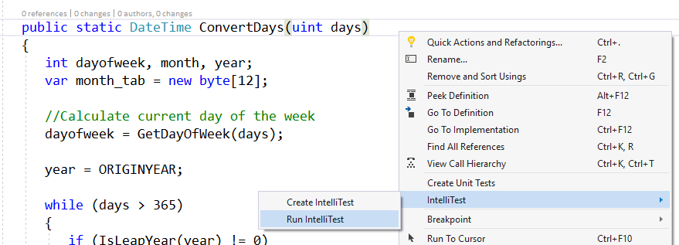
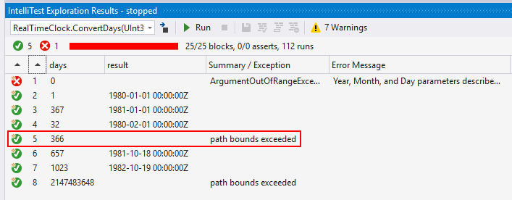
Analysis
Notes:
We can also use Intellitest to generate tests for us and exercise our code's boundary conditions (show what happens with the Zune bug). Note that this requires Enterprise SKU, so that's probably not doable for everyone, but it is an option.

Slide 15
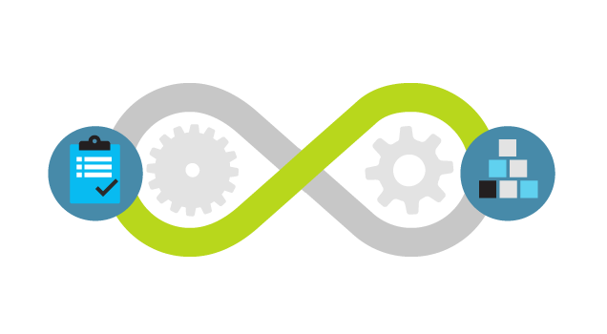
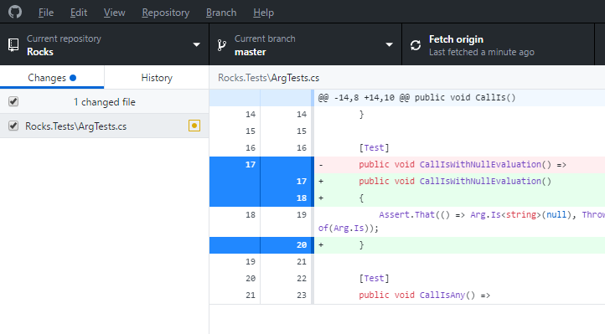
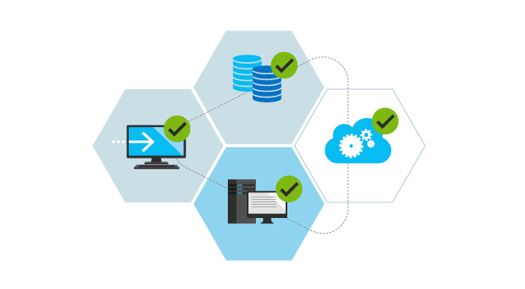
Analysis
https://www.visualstudio.com/vs/devops/
https://desktop.github.com/
Notes:
Another process is to do code reviews. Part of that is a traditional manual code review. Doing this with modern tools (diffs, DevOps notifications, etc.) is much easier than it ever has been.

Slide 16


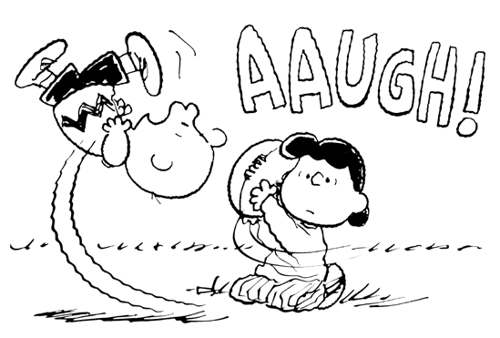
Analysis
http://www.plognark.com/Art/Sketches/Blogsketches/2008/thestupiditburns.jpg
https://grist.files.wordpress.com/2010/09/charlie-brown-football.gif
http://www.trbimg.com/img-5888c4de/turbine/ct-sick-kids-home-from-school-20170125
Notes:
But that relies on humans, who may be stressed out, having a bad day, or sick. They will miss things.

Slide 17
Analysis
public Customer Get(int id) =>
new CustomerService().Get(id);
public class CustomerService
: IDisposable { /* ... */ }
Notes:
Would you be able to see this issue out of the gate with not disposing something that implements IDisposable?

Slide 18
Analysis
if(Program.GetNames().Count() > 2
private static List<string> GetNames()
Notes:
Or this one? This should really use the “.Count” property, not the “.Count()” LINQ extension method.

Slide 19
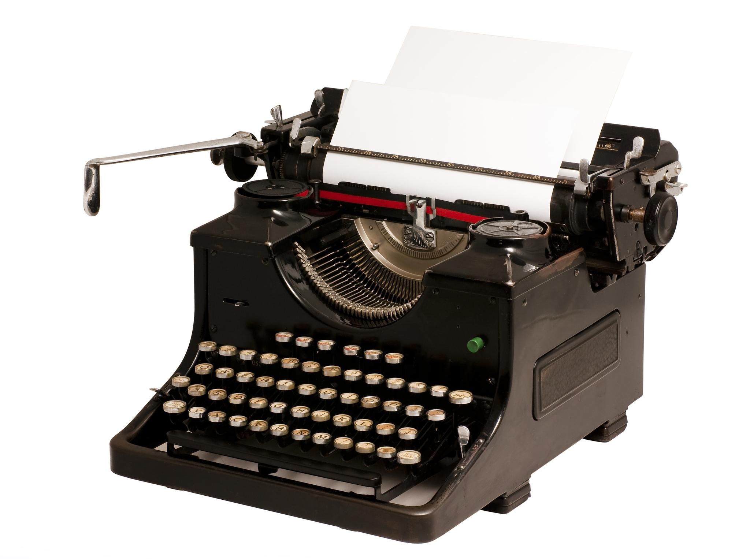
Analysis
There are a finite number of keystrokes left in your hands before you die.
http://blog.timesunion.com/opinion/files/2011/02/0214_WVhuffpostAOL.jpg
https://www.hanselman.com/blog/DoTheyDeserveTheGiftOfYourKeystrokes.aspx
Notes:
We want to find issues as soon as we type code. The quote may be morbid, but it’s true!

Slide 20
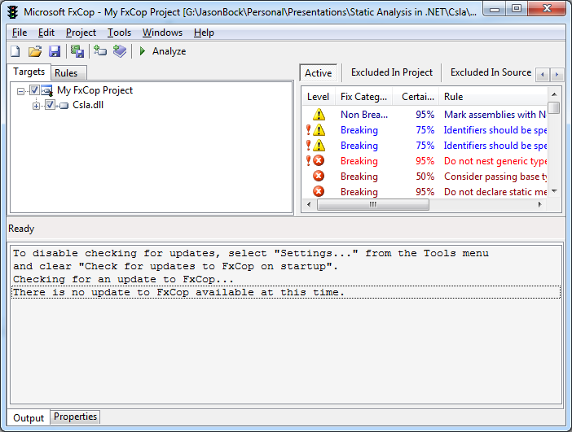
Analysis
https://msdn.microsoft.com/en-us/library/bb429476(v=vs.80).aspx
https://blogs.msdn.microsoft.com/codeanalysis/2010/07/26/fxcop-10-0-is-available/
Notes:
FxCop has been around for a long time. In fact, this screen shot was from another slide deck I did years ago. That should be an indicator of how old this tool is.

Slide 21
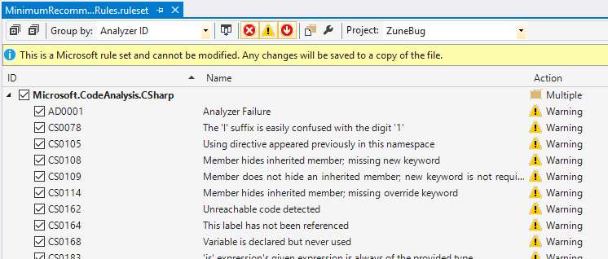
Analysis
Notes:
Then it got “in the box” as the “Code Analysis” tool.

Slide 22

Analysis
write code
compile
code
static analysis tool
review results
http://www.publicdomainpictures.net/pictures/80000/nahled/clock-icon.jpg
Notes:
But the problem is the timing. It won't do anything until you successfully compile code. It only works at the assembly level.

Slide 23
Analysis
write code
compile
code
static analysis tool
review results
http://www.publicdomainpictures.net/pictures/80000/nahled/clock-icon.jpg
Notes:
We want something that works as you type.

Slide 24

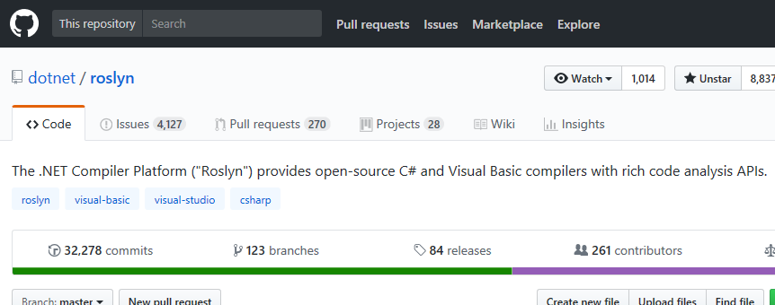
Analysis
https://github.com/dotnet/swag/blob/master/roslyn/roslyn_kuhlenh.png
https://github.com/dotnet/roslyn
Notes:
Thankfully we now have the Compiler API, which allows us to write analyzers that can find issues as soon as you type.

Slide 25
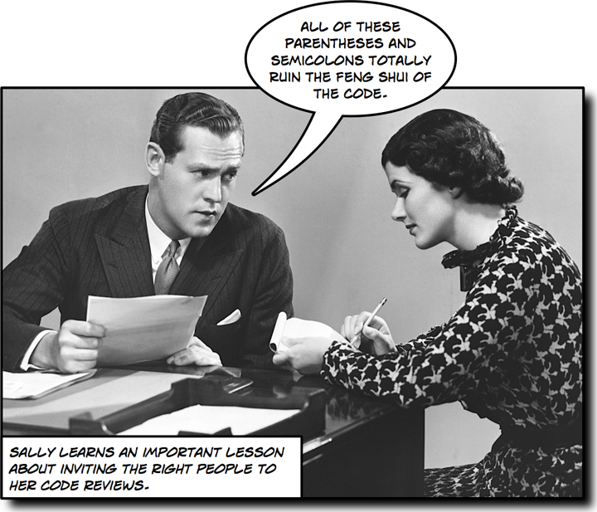
Analysis
http://www.stellman-greene.com/blog/wp-content/uploads/2008/09/sally-code-review.png
Notes:
Side note: doing analysis for formatting issues is a good thing. But don’t argue over them for hours at a time, just pick something to be consistent.

Slide 26
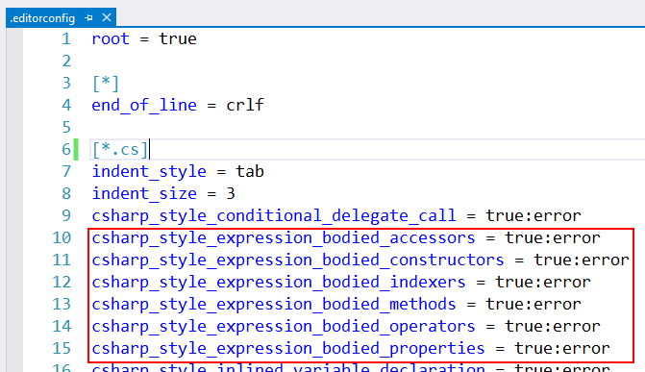
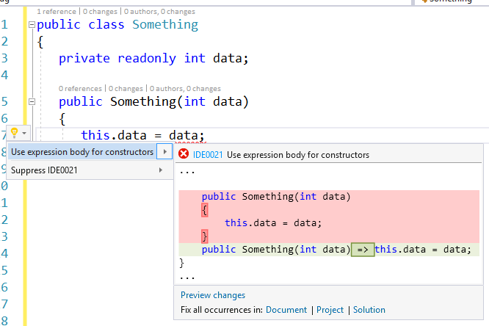
Analysis
Notes:
That's what .editorconfig can do

Slide 27

Analysis
http://i5.asn.im/couple-arguing-_ucgr.jpg
Notes:
But don't argue over them.

Slide 28
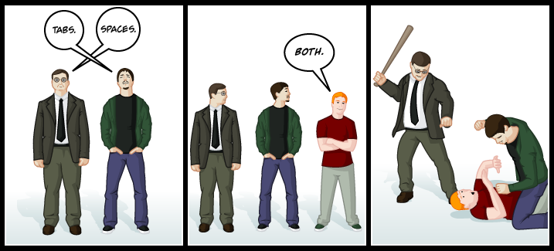
Analysis
http://www.emacswiki.org/pics/static/TabsSpacesBoth.png
Notes:
Just agree on something and be consistent.

Slide 29
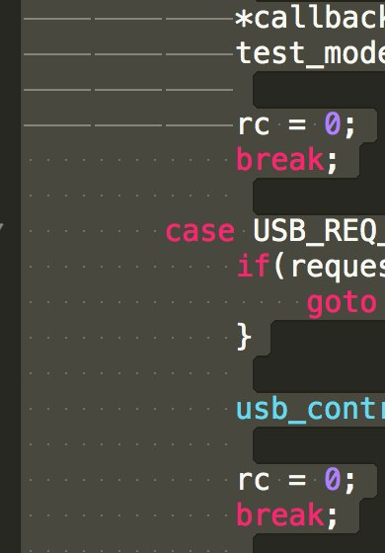
Analysis
https://twitter.com/StackSmashing/status/961658232841400320
https://pbs.twimg.com/media/DVh-ti-WAAArU1A.jpg:large
Notes:
Side note: apparently Apple does this ☺

Slide 30
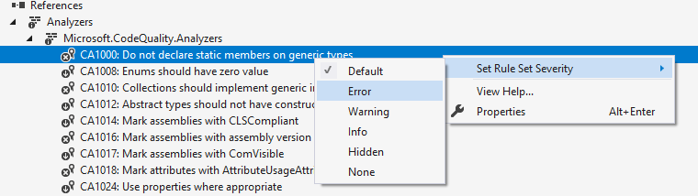
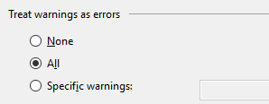
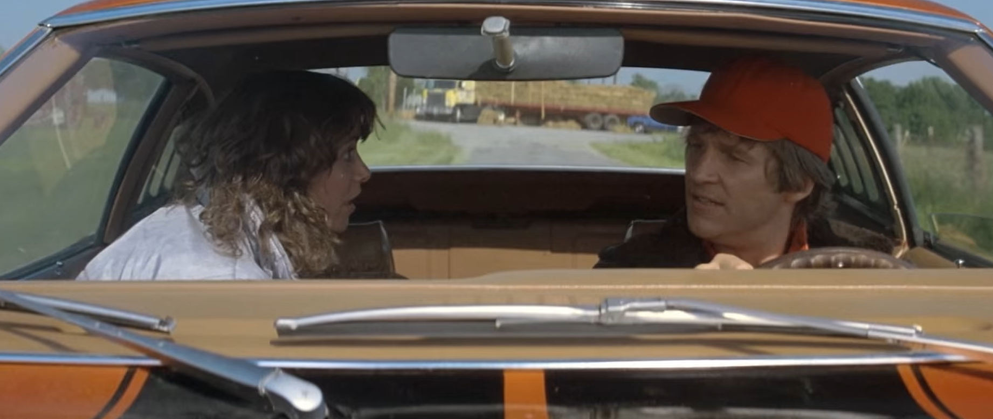
Analysis
https://www.youtube.com/watch?v=g3WtvzmKCQQ
Notes:
One request: STRONGLY CONSIDER turning on "warning as errors" in new projects and setting rule severities to “Error”. In most cases, those compiler warnings should be in your face, and a yellow light will be ignored.

Slide 31
Analysis
SonarQube (https://www.sonarqube.org/)
NDepend (https://www.ndepend.com/)
Code Cracker (https://code-cracker.github.io/)
CodeIt.Right (https://submain.com/products/codeit.right.aspx)
Refactoring Essentials (http://vsrefactoringessentials.com/)
PVS Studio (https://www.viva64.com/en/pvs-studio/)
Coverity (https://scan.coverity.com/)
Puma Scan (https://www.pumascan.com/)
And many others…
Notes:
Also: there are other products you can use. I won't show any of them here, but you are encouraged to check them out and evaluate them.

Slide 32
Demo: Analyzing Code with .editorconfig and Analyzers
Analyzing Code in .NET
Notes:
Let’s see how .editorconfig can affect code styles, and what happens when you add analyzers to a project and what they can find.

Slide 33
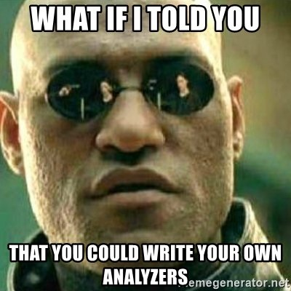
Building
https://memegenerator.net/instance/81305253/what-if-i-told-you-what-if-i-told-you-that-you-could-write-your-own-analyzers
Notes:
So….that's great. You can write your own .editorconfig, and you can get analyzers from Nuget packages. But….what if you want to write your own?

Slide 34
Building
using System;
[Serializable]
public sealed class Customer
: BusinessBase<Customer>
{
/* ... */
}
Notes:
CSLA is a business object library I’ve used. CSLA has some conventions that you must adhere to. For example, all CSLA-based classes must be serializable. In this example, we don’t have [Serializable], and when we get to distributing the object across the wire, it’ll fail.

Slide 35
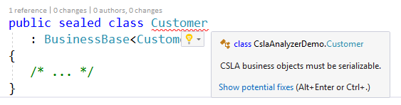
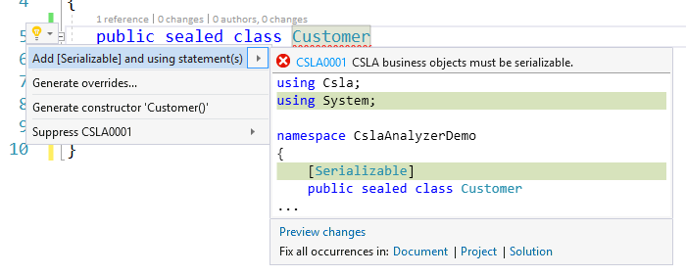
Building
Notes:
With the Compiler API, you can write your own analyzers to not only show that error, but provide a code fix so developers can rectify the problem easily.

Slide 36
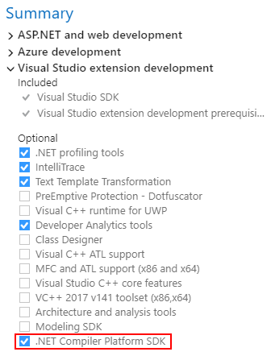
Building
Notes:
First, make sure you’ve installed the .NET Compiler Platform SDK.

Slide 37
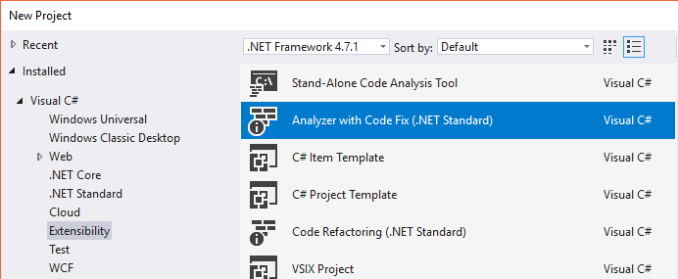
Building
Notes:
Then, you’ll get a project template that will generate the scaffolding for you with a simple analyzer and code fix built in. This shows you the machinery of analyzers and code fixes.

Slide 38
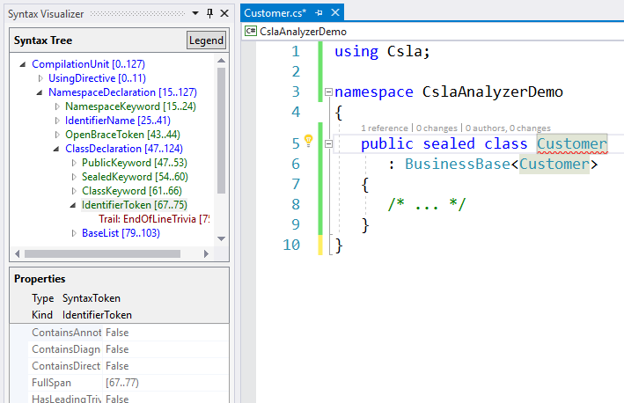
Building
Notes:
You’ll want to have the Syntax Visualizer window up (which comes with the SDK install) as it helps you figure out what you’re looking for in the tree.

Slide 39
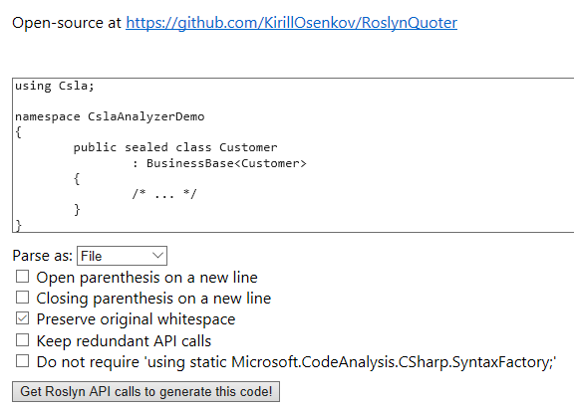
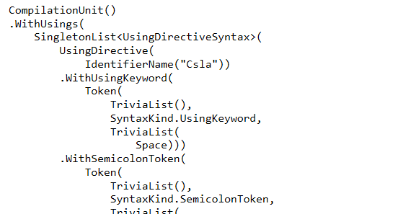
Building
http://roslynquoter.azurewebsites.net/
Notes:
For code fixes, the Roslyn Quoter tool helps you figure out the syntax elements you need to generate.

Slide 40
Demo: Writing an Analyzer and Code Fix
Analyzing Code in .NET
Notes:
Let’s see how I wrote some of the analyzers and code fixes for CSLA.

Slide 41

Conclusion
http://snowbrains.com/wp-content/uploads/2013/04/mount-everest.jpg
Notes:
Now, this isn't easy. In fact, at first it may feel like climbing Mount Everest. There's no way around this, you're doing stuff with tokens, symbols, etc. - things that are at a compilation level, and it's not easy.

Slide 42

Conclusion
http://worldwide.streamer.espeakers.com/assets/9/9179/30001.jpg
Notes:
If you stick with it, you’ll have a great view of your code.

Slide 43

Conclusion
http://img09.deviantart.net/a849/i/2010/219/6/f/energy_ball_by_wylland.jpg
Notes:
Using analyzers and being able to write your own – those are powerful tools. I strongly encourage you to use ones that exist and create your own for cases you’re running into with your own code.

Slide 44
Analyzing Code in .NET
Remember…
https://github.com/JasonBock/Presentations/blob/master/Analyzing%20Code%20In%20.NET.pptx
https://github.com/JasonBock/AnalyzingCodeInDotNet
https://github.com/MarimerLLC/csla
Links to code and slide deck
References in the notes on this slide
Jason Bock
Practice Lead
Notes:
* .NET Development Using the Compiler API - https://www.apress.com/us/book/9781484221105
* Automating Code Reviews in .NET - https://magenic.com/media/2669/automating-code-reviews-in-net.pdf
* Roslyn Analyzer IDs Problem .NET Core, .NET Standard APIs - https://visualstudiomagazine.com/articles/2017/11/07/api-analyzer.aspx
* Rigging up Roslyn Analyzers in .NET Core - https://blogs.msdn.microsoft.com/devfish/2017/11/09/rigging-up-roslyn-analyzers-in-net-core/
* Your New Virtual API Review Assistant - https://channel9.msdn.com/coding4fun/blog/Your-New-Virtual-API-Review-Assistant
* Code Analysis, Profiling and Refactoring Tools for Visual Studio 2017 - https://visualstudiomagazine.com/Articles/2017/10/01/Code-Analysis.aspx
* Hands-free Security Scanning within .NET Applications - http://rion.io/2017/10/02/hands-free-security-scanning-within-net-applications/
* Amazon Says One Engineer's Simple Mistake Brought the Internet Down - http://gizmodo.com/amazon-says-one-engineers-simple-mistake-brought-the-in-1792907038
* Summary of the Amazon S3 Service Disruption in the Northern Virginia (US-EAST-1) Region - https://aws.amazon.com/message/41926/?tag=gizmodoamzn-20&ascsubtag=d4705d0fcbaa3d7dea98dcccbf155390f1065cbe&rawdata=%5Bt%7Clink%5Bp%7C1792907038%5Bau%7C452356546%5Bb%7Cgizmodo
* Everything You Need to Know About Cloudbleed, the Latest Internet Security Disaster - http://gizmodo.com/everything-you-need-to-know-about-cloudbleed-the-lates-1792710616
* Incident report on memory leak caused by Cloudflare parser bug - https://blog.cloudflare.com/incident-report-on-memory-leak-caused-by-cloudflare-parser-bug/
* Windows Azure storage issue: Expired HTTPS certificate possibly at fault - http://www.zdnet.com/article/windows-azure-storage-issue-expired-https-certificate-possibly-at-fault/
* Windows Azure Service Disruption from Expired Certificate - https://azure.microsoft.com/en-us/blog/windows-azure-service-disruption-from-expired-certificate/
* Back to Basics: Explore the Edge Cases or Date Math will Get You - http://www.hanselman.com/blog/BackToBasicsExploreTheEdgeCasesOrDateMathWillGetYou.aspx
* Zune bug explained in detail - https://techcrunch.com/2008/12/31/zune-bug-explained-in-detail/
* Roslyn-Analyzers - https://github.com/dotnet/roslyn-analyzers
* Microsoft Code Analysis 2017 - https://marketplace.visualstudio.com/items?itemName=VisualStudioPlatformTeam.MicrosoftCodeAnalysis2017
* SonarQube - https://www.sonarqube.org/
* SonarC# - https://www.sonarsource.com/products/codeanalyzers/sonarcsharp.html
* SonarLint for Visual Studio - http://www.sonarlint.org/visualstudio/index.html
* SonarAnalyzers - https://www.nuget.org/packages/SonarAnalyzer.CSharp/

